Slide 1
CASE STUDY 1
A company has a large number of Issues coming up with the service desk that need to be sorted into one of three categories: Software/Hardware , HR, Finance. They have been able to identify a number of phrases which are commonly used in these documents and may help disambiguate them but there are a large number (thousands) of these phrases and each one only appears in a small number of documents. Thankfully someone has labeled a few hundred documents for you but you need to build a method to automatically label the rest. Highlight the List of Steps to be performed in this case to solve this problem
1.Highlight the Problem Statement
2.Define the Data requirement
3.Data Cleansing
4.Solution Development
5.Implementation

Slide 2
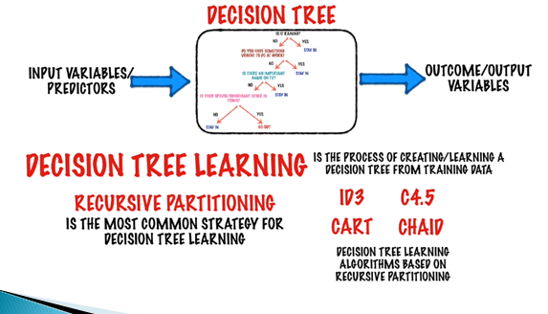
Decision Tree

Slide 3
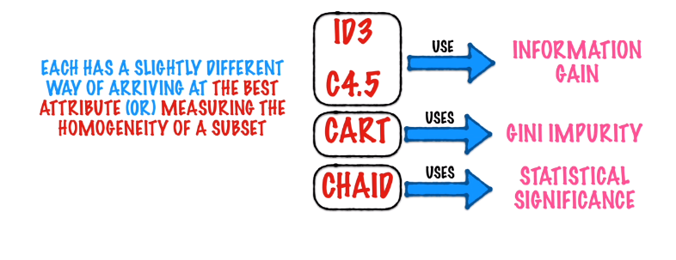

Slide 4
Decision Trees
A decision tree is a decision support tool that uses a tree-like graph or model of decisions and their possible consequences, including chance event outcomes, resource costs, and utility. It is one way to display an algorithm that only contains conditional control statements

Slide 5
Decision Trees –Key Points
Works for both Categorical and Continuous Variables
Categorical Decision Tree :
Decision Tree which has categorical target variable then it called as categorical variable decision tree
Continuous Decision Tree:Decision Tree has continuous target variable then it is called as Continuous Variable Decision Tree.

Slide 6
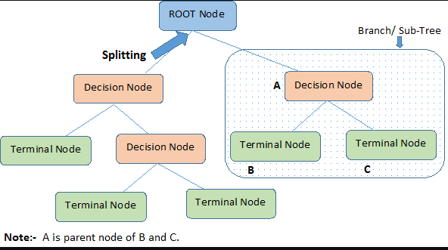
Concepts
Pruning: When we remove sub-nodes of a decision node, this process is called pruning. You can say opposite process of splitting.
Parent and Child Node: A node, which is divided into sub-nodes is called parent node of sub-nodes where as sub-nodes are the child of parent node.

Slide 7
Advantages
Easy to Understand
Requires Less Data Cleansing
Applicable for both categorical and continuous variables
Disadvantages
Overfitting
Loss of Information by binning continuous variables

Slide 8
Top Down Approach
It begins at the top of the tree and then successively splits the predictor variable .Each split is indicated by two new branches further down on the tree.
It is greedy because at each step of the tree-building process, the best split is made at that particular step, rather than looking ahead and picking a split that will lead to a better tree in some future step.

Slide 9
Bagging
Repeating the above process of building a decision tree reduces the variance of error
Bagging is a methodology of building tree repeatedly using different samples from same data
This can be applied to both Regression and Classification trees

Slide 10
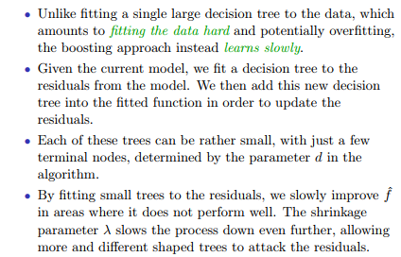
Boosting

Slide 11
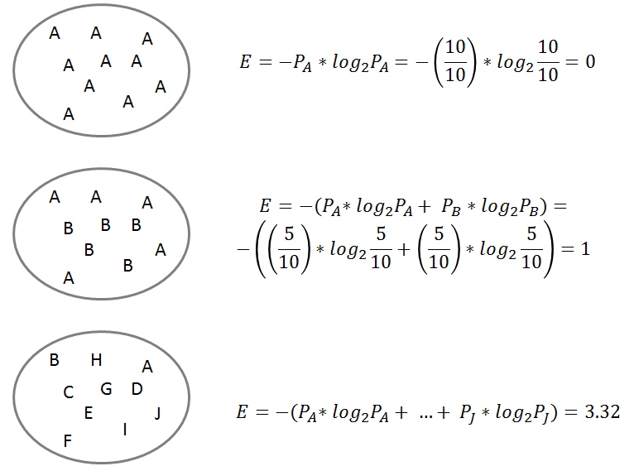
ENTROPY
A dataset with a low entropy level is very predictable; a dataset with a high level of entropy is very hard to predict
Entropy measures the homogeneity of a dataset.

Slide 12
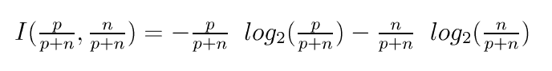
Information or Entropy
Information or Entropy measures the “randomness” of an arbitrary collection of examples.
We don’t have exact probabilities but our training data provides an estimate of the probabilities of positive vs. negative examples given a set of values for the attributes.
For a collection S, entropy is given as:
For a collection S having positive and negative examples
p - # positive examples;
n - # negative examples

Slide 13
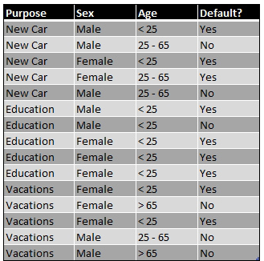
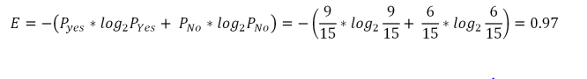
Example

Slide 14
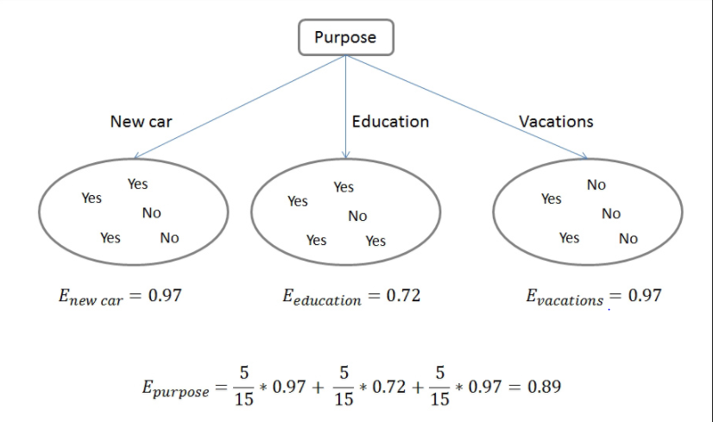
Example

Slide 15
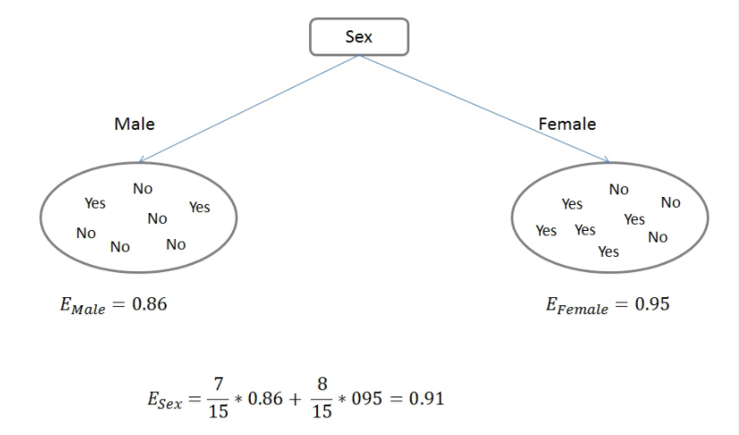

Slide 16
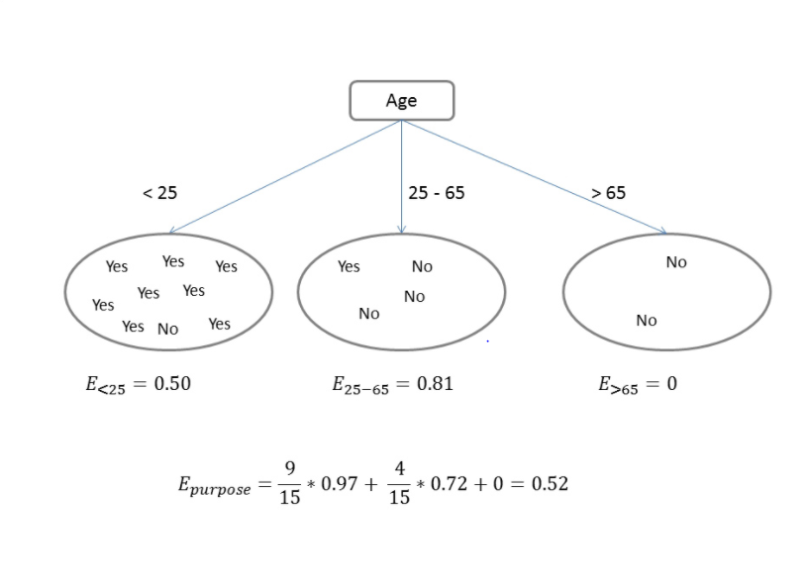

Slide 17
Information Gain
The information gain is a measure of the decrease of entropy you achieve when you split a dataset. We use it in the process of building a Decision Tree
Information Gain
Reduces Entropy
Increases Information

Slide 18
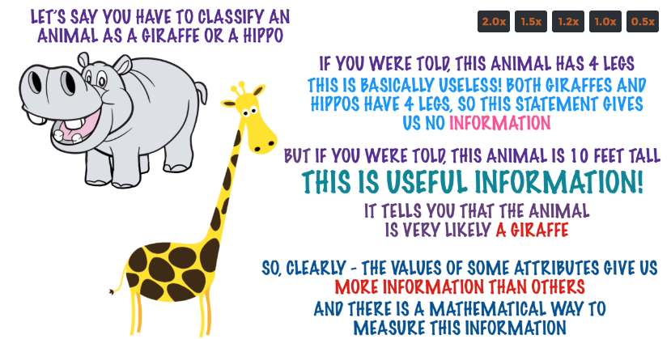

Slide 19
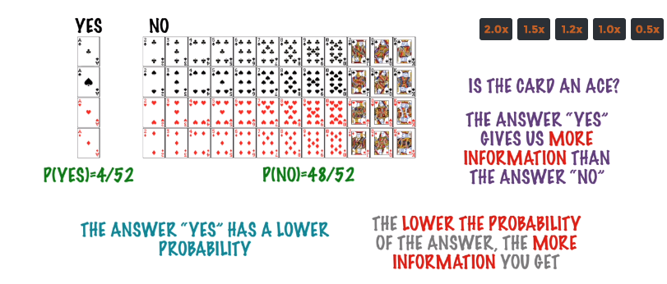
Guess the Card your opponent has out of 52 cards .
Is the Card an Ace ?

Slide 20
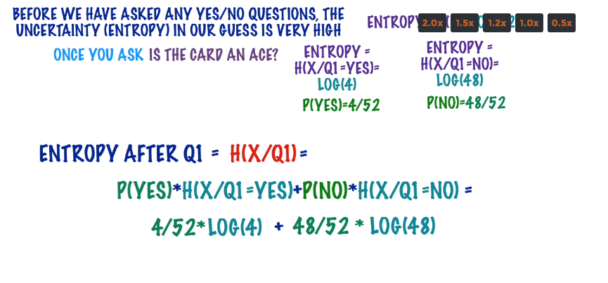

Slide 21
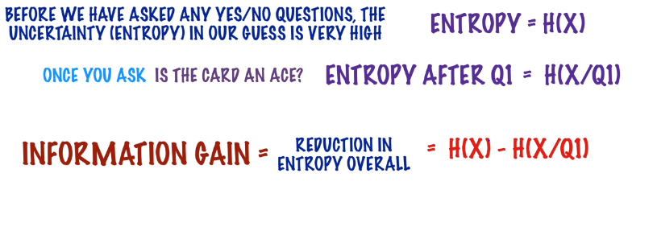

Slide 22
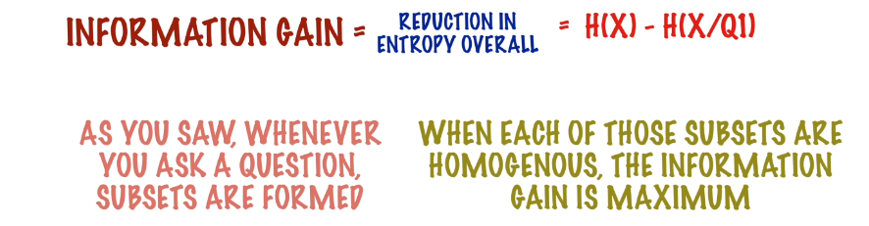
Information Gain is biased to attributes with more level ?

Slide 23
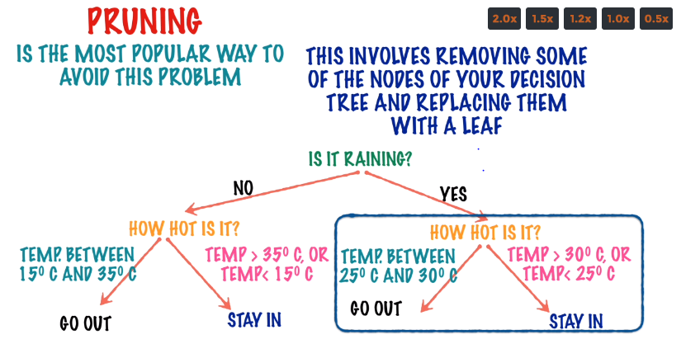

Slide 24
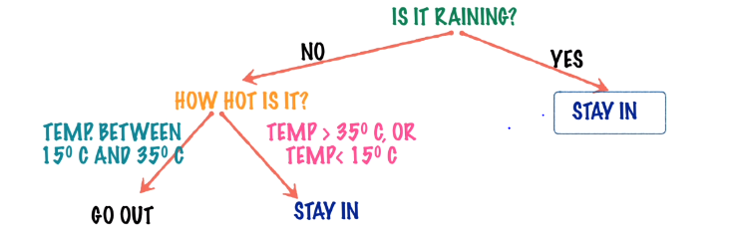

Slide 25
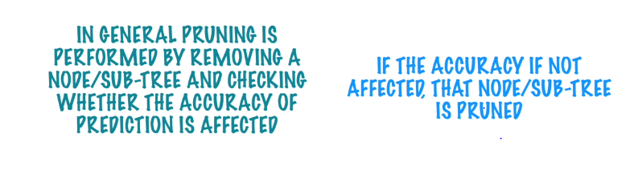

Slide 26
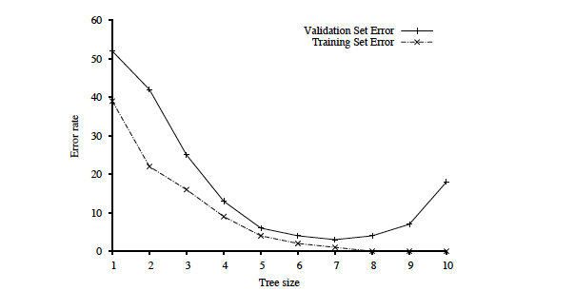
Key figure in machine learning
We set tree size as
a parameter in our
DT learning alg.
Optimal tree size
Error rate
Overfitting kicks in…
Tree size
error_{T}(h) < error_{T}(h’) but
error_{D}(h) > error_{D}(h’)
Note: with larger and larger trees,
we just do better and better on the training set!
But note the performance on the validation set…

Slide 27
Issues by Over fitting Models –Decision Tree

Slide 28
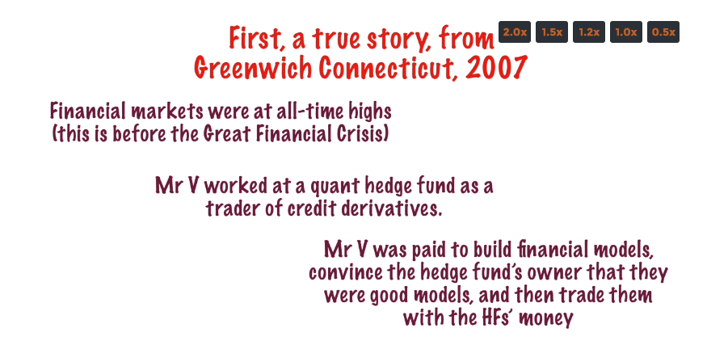

Slide 29
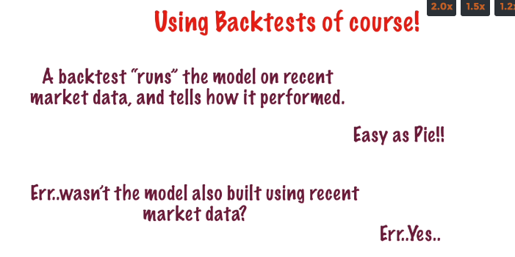

Slide 30
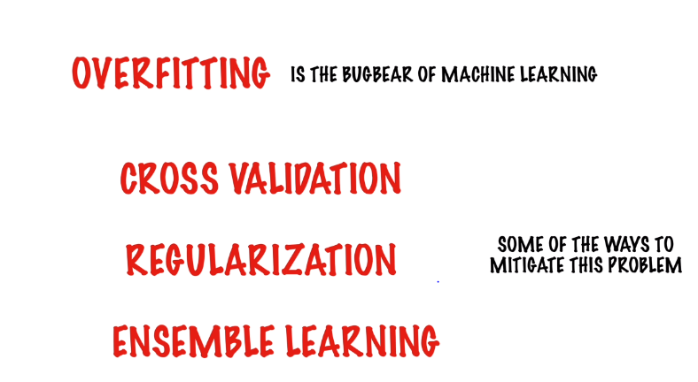

Slide 31
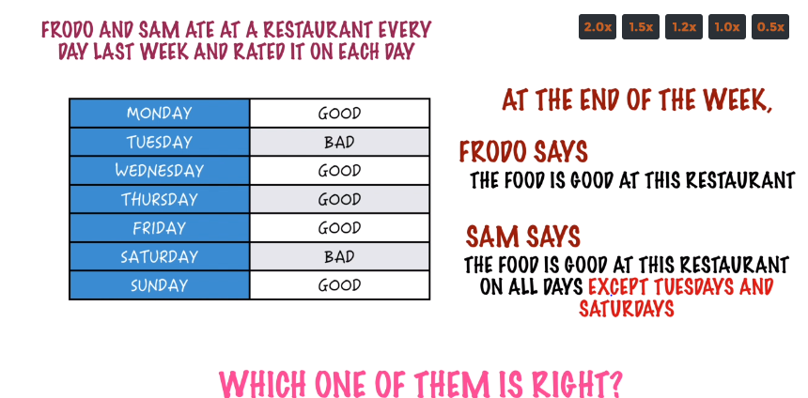

Slide 32
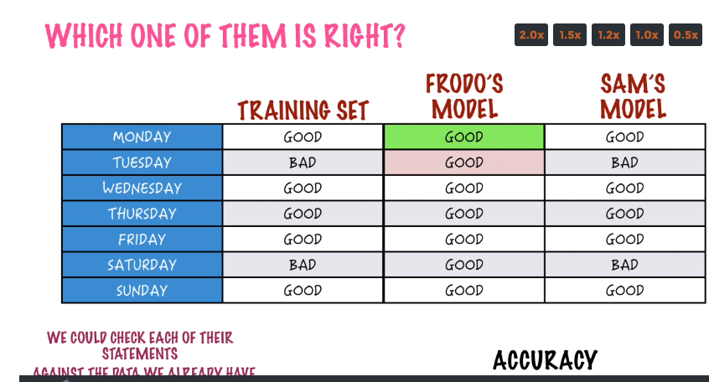

Slide 33
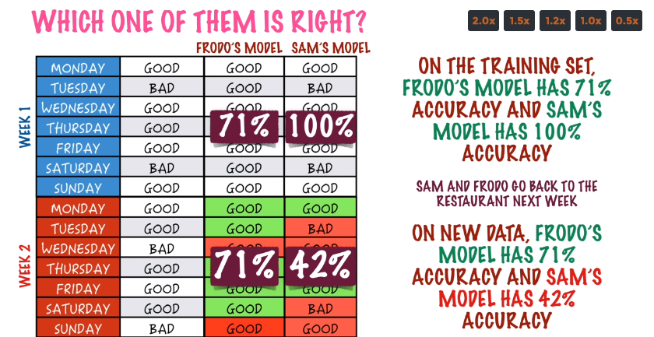

Slide 34
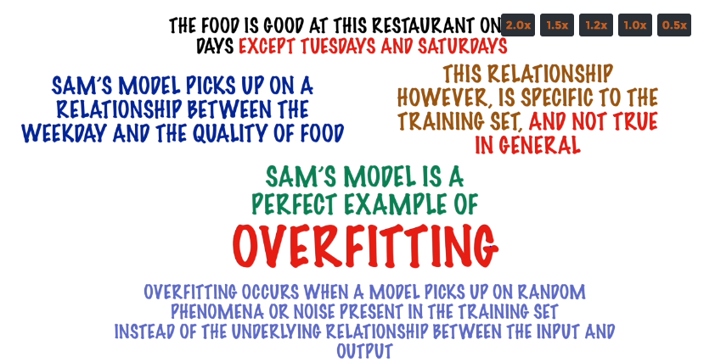

Slide 35
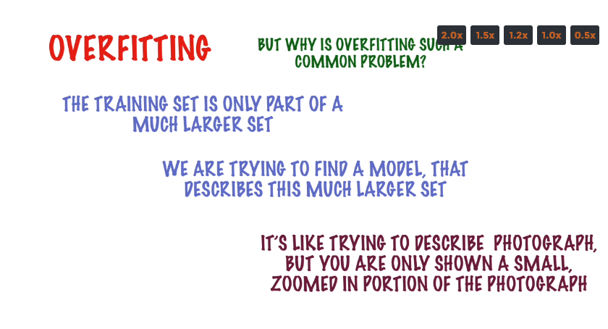

Slide 36
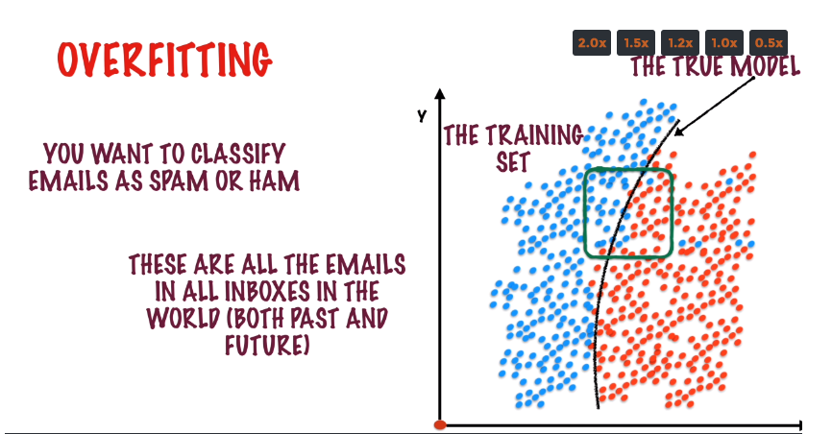

Slide 37
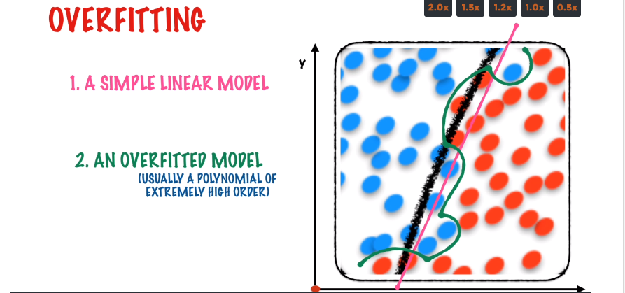

Slide 38
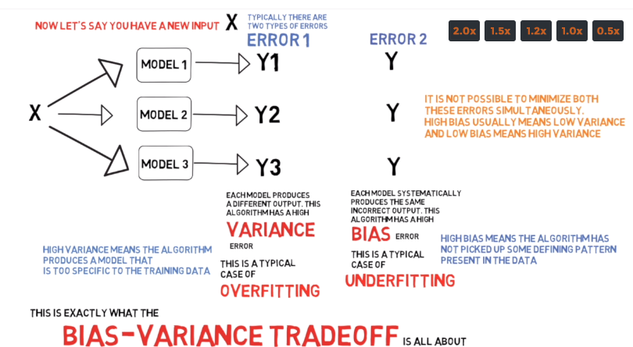

Slide 39
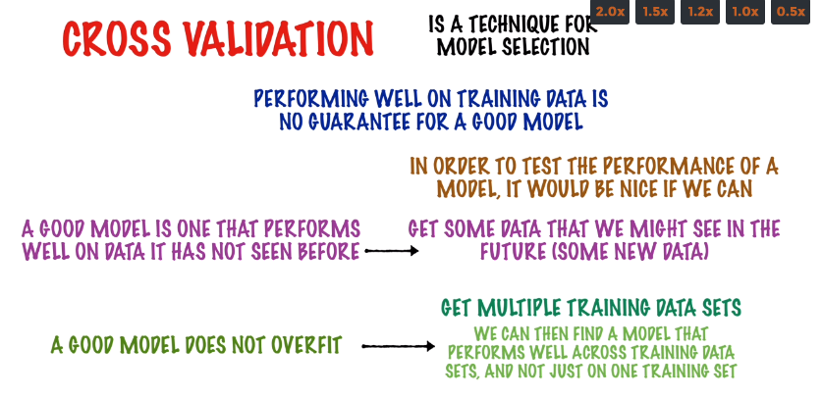

Slide 40

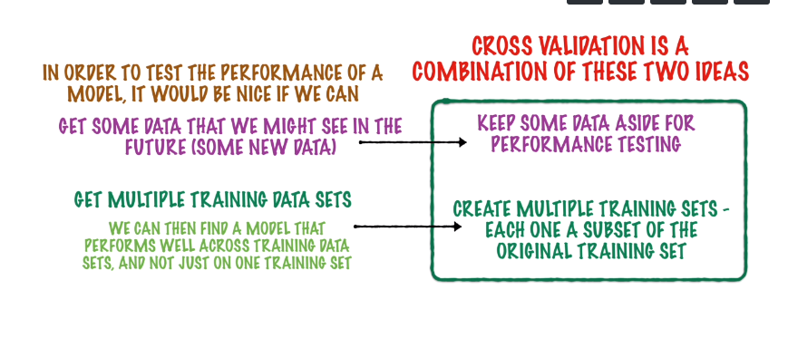

Slide 41
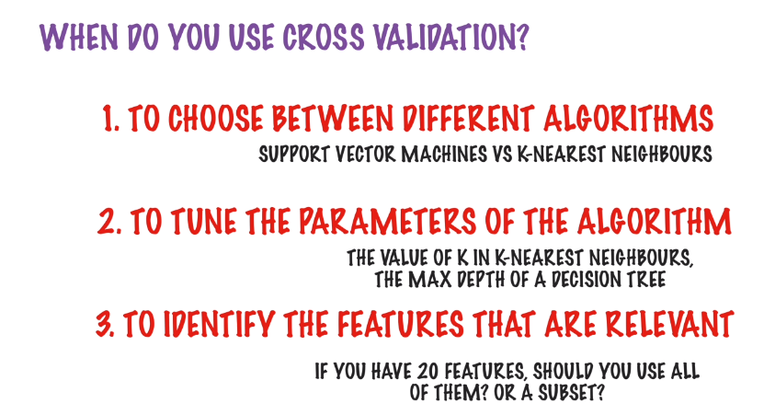

Slide 42
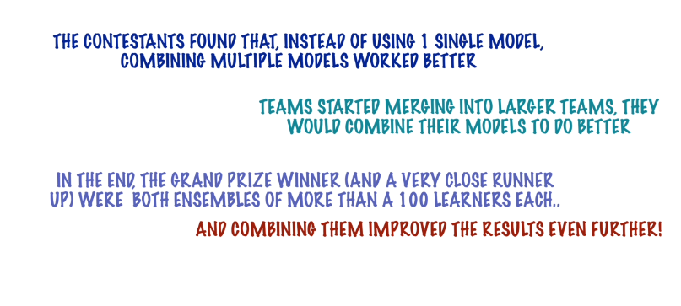
NET FLIX CONTEST

Slide 43
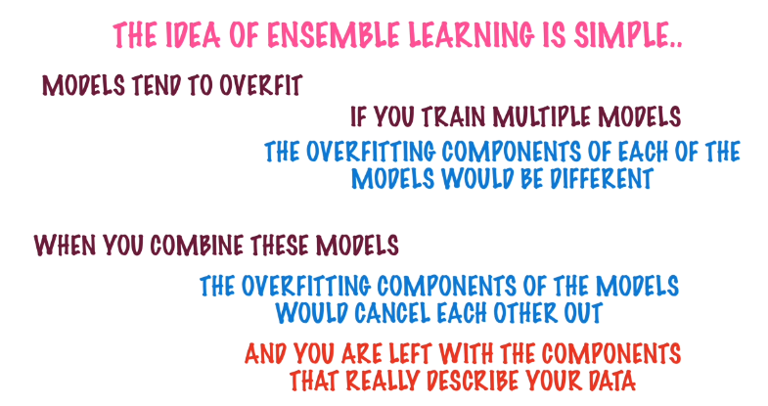

Slide 44
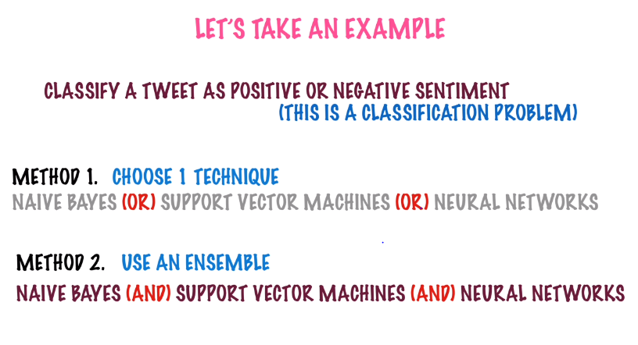

Slide 45
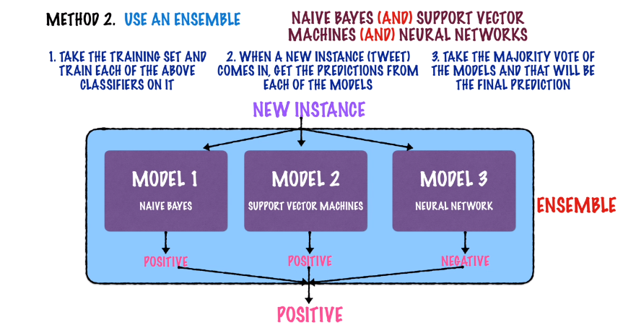

Slide 46
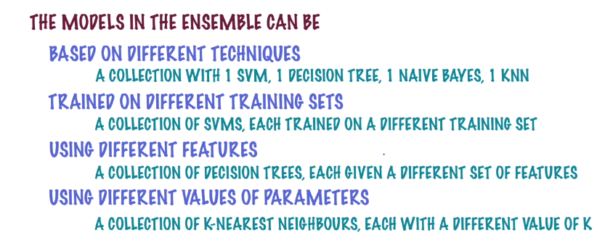

Slide 47
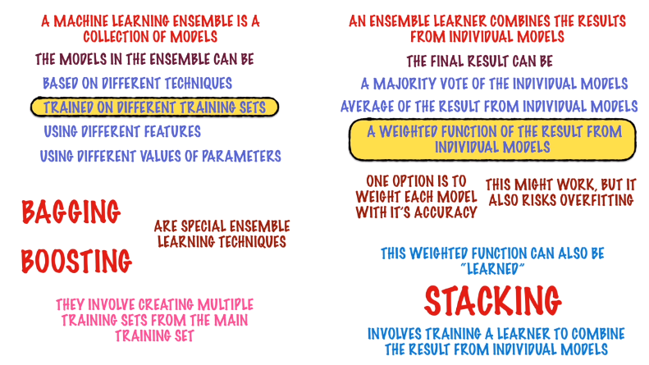

Slide 48
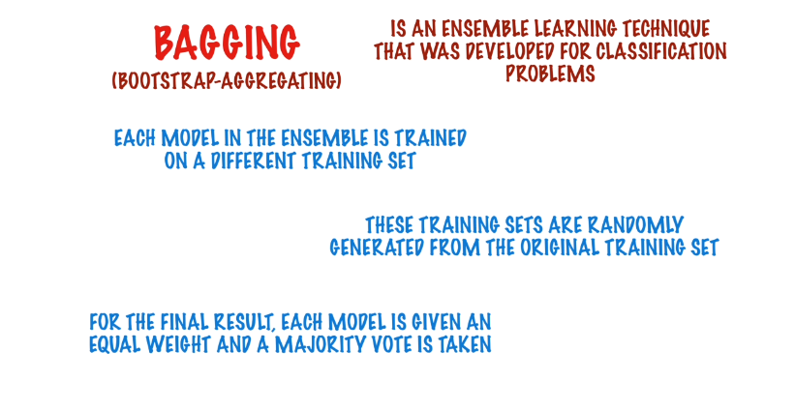

Slide 49
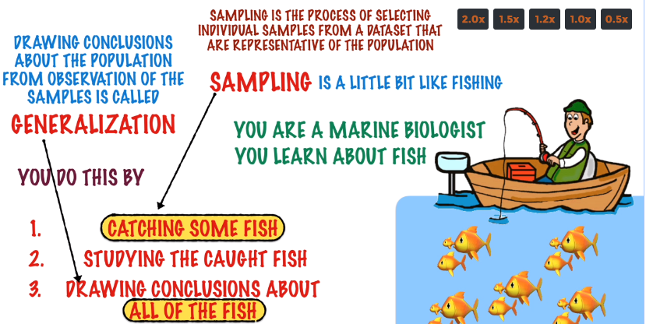

Slide 50
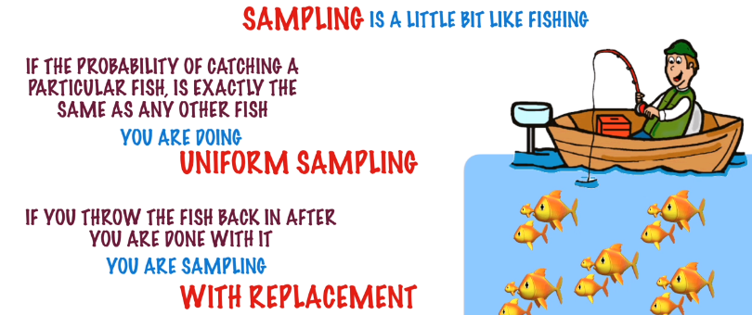

Slide 51
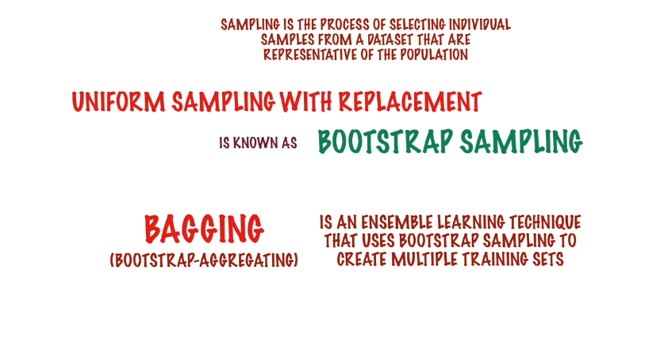

Slide 52
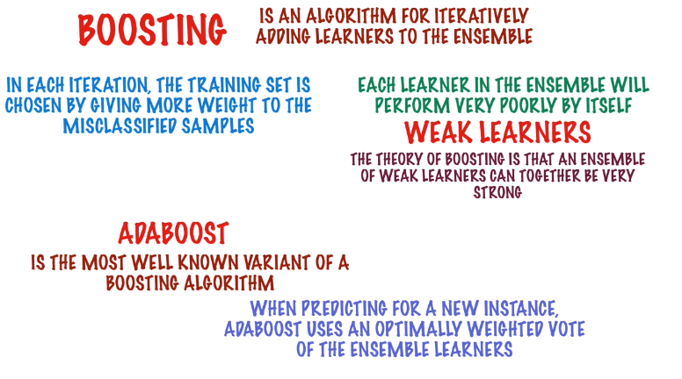

Slide 53
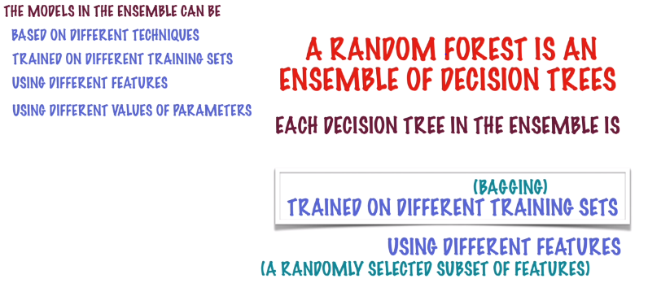

Slide 54
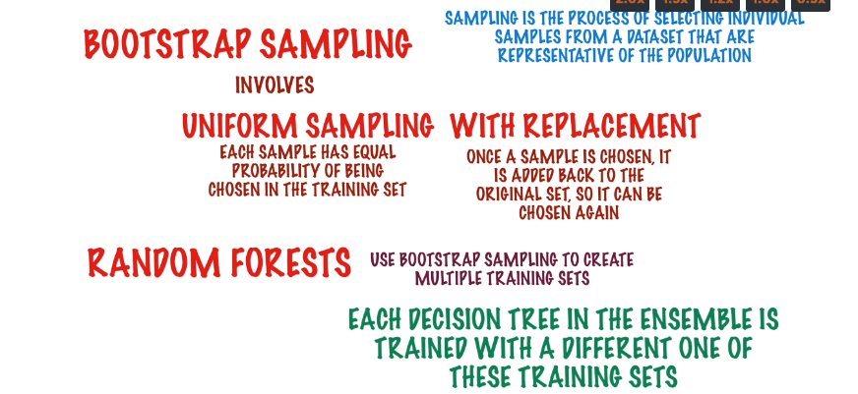

Slide 55
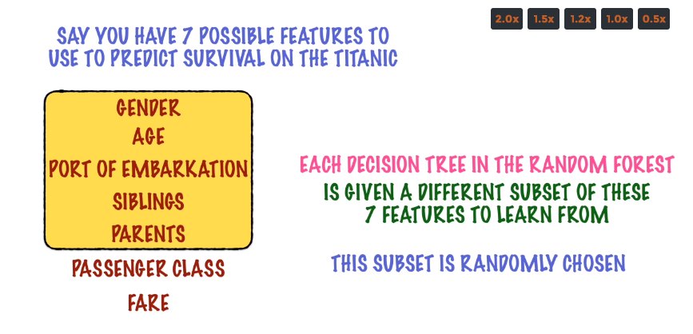

Slide 56
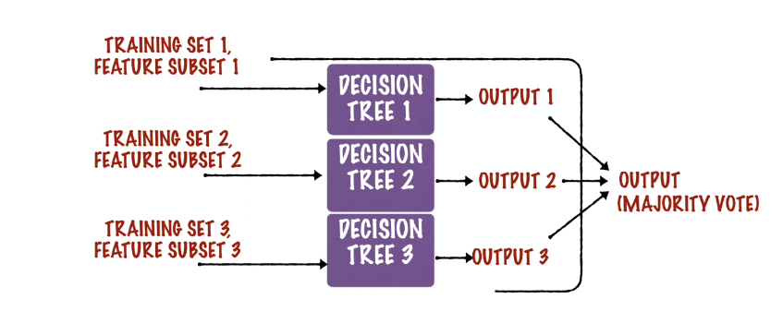

Slide 57
CLUSTERING

Slide 58
What is clustering?
Ch. 16
Clustering: the process of grouping a set of objects into classes of similar objects
Documents within a cluster should be similar.
Documents from different clusters should be dissimilar.
The commonest form of unsupervised learning
Unsupervised learning = learning from raw data, as opposed to supervised data where a classification of examples is given
A common and important task that finds many applications in IR and other places

Slide 59
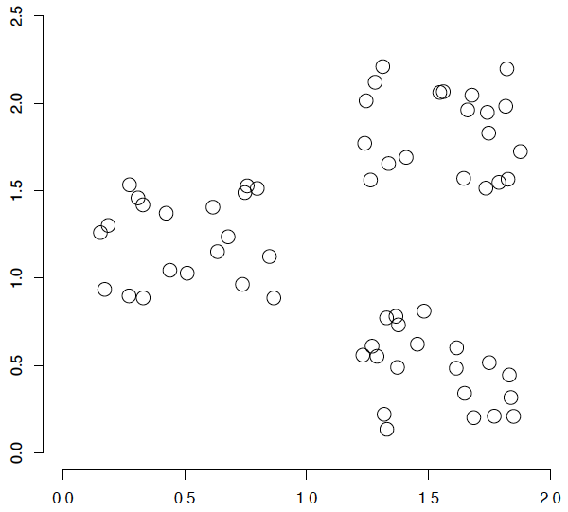
A data set with clear cluster structure
Ch. 16
How would you design an algorithm for finding the three clusters in this case?

Slide 60
Topic Modelling
agriculture
biology
physics
CS
space
...
...
...
...
...
dairy
crops
botany
cell
AI
courses
craft
magnetism
HCI
missions
forestry
agronomy
evolution
relativity
Notes:
Final data set:
Yahoo Science hierarchy, consisting of text of web pages pointed to by Yahoo, gathered summer of 1997.
264 classes, only sample shown here.

Slide 61

Google News: automatic clustering gives an effective news presentation metaphor

Slide 62
For improving search recall
Sec. 16.1
Cluster hypothesis - Documents in the same cluster behave similarly with respect to relevance to information needs
Therefore, to improve search recall:
Cluster docs in corpus a priori
When a query matches a doc D, also return other docs in the cluster containing D
Hope if we do this: The query “car” will also return docs containing automobile
Because clustering grouped together docs containing car with those containing automobile.
Why might this happen?

Slide 63
K Means Example (K=2)
Sec. 16.4
Pick seeds
Reassign clusters
Compute centroids
Reassign clusters
x
x
x
Compute centroids
x
x
x
Reassign clusters
Converged!

Slide 64
Convergence
Sec. 16.4
Why should the K-means algorithm ever reach a fixed point?
A state in which clusters don’t change.
K-means is a special case of a general procedure known as the Expectation Maximization (EM) algorithm.
EM is known to converge.
Number of iterations could be large.
But in practice usually isn’t

Slide 65


1
2
Find arbitrary centroids
Cluster Assignments
Cluster Assignments prepared based on distance

Slide 66



1.Randomly Assign K –Centroids
2.Find the Cluster assignment based on distance measure
3.Find the average of the points assigned to Cluster k
4.Do this iteratively
Distance measure :
a.Euclidean
b. Manhattan
5.Objective is to minimize the squared distance between each point and the corresponding centroid assigned

Slide 67

MANHATTAN VS EUCLIDEAN DISTANCE

Slide 68

ELBOW METHOD

Slide 69

What is Segmentation ?
What is customer segmentation ?
Based on certain attributes natural sub groups are formed within the customers such that it makes business sense
Surfacing customer groups that show commonality of behavior.

Slide 70

Characteristics of Clusters
A cluster is a group of relatively homogenous cases or observations.
Cluster analysis is an exploratory data analysis tool for solving classification problems.
The degree of association is strong between members of the same cluster and weak between members of different clusters.
Clusters must help achieve business objective
The results of a survey that studied drinkers' perceptions of spirits (alcohol).

Slide 71
Why Segmentation?
Segmentation as a CRM Tool
Segmentation for Mass Customization
Segmentation for Targeted Marketing
Segmentation for controlling costs
Segmentation for developing new customers and markets

Slide 72
Who Can be segmented?
Customer Segmentation
Store Segmentation
Product Segmentation
Prospect Segmentation
Employee Segmentation
Agent Segmentation
Partner Segmentation
Market Segmentation

Slide 73
Business Questions Answered by Segmentation
Which customer segments are the most profitable?
Which segment has the highest opportunity for growth?
Which prospects should my campaign target?
How should I direct my finite marketing budget?
Which customers should I spend money on retaining?
To which customers should I cross-sell, and what products?
What is the right channel for cross-selling?
How can we proactively interact with the clients based on their needs?
What are the main reasons for which the customers seek assistance?

Slide 74
Agenda
Segmentation Concept
Types of Segmentation
Clustering Techniques
Segmentation Methodology
Segmentation Best Practices
Segmentation Application
CPG/Retail Industry
Travel Industry
Insurance

Slide 75
Types of Segmentation
Value based Segmentation
Behavioral Segmentation
Loyalty Segmentation
Propensity based Segmentation
Socio-demographic and Life-stage segmentation
Need attitudinal segmentation

Slide 76
Agenda
Segmentation Concept
Types of Segmentation
Clustering Techniques
Segmentation Methodology
Segmentation Best Practices
Segmentation Application
CPG/Retail Industry
Travel Industry
Insurance

Slide 77


Clustering Techniques
Hierarchical Clustering: Hierarchical clustering is a method of cluster analysis which seeks to build a hierarchy of clusters.
K-means(Enhanced): K-Means is a distance based algorithm that partitions the data into a predetermined number of clusters.
O-Clustering: Clusters are regarded as regions in the data space in which the objects are dense, and which are separated by regions of low object density (noise).
 | ODM | SAS | Spotfire
Hierarchical
K-Means
O Cluster

Slide 78
Clustering Techniques Pros and Cons
 | Hierarchical | K-Means | O-Cluster
Advantages | Hierarchical clustering outputs a hierarchy, a structure that is more informative. | Easy to Understand. | The no. of clusters are automatically determined.
 | Does not require us to prespecify the number of clusters | Can handle data set of any size. | Fast Processing Time.
Disadvantages | Come at the cost of lower efficiency. | The no. of clusters are user specified. | Appropriate for large data sets ( > 500 records ).
 |  | Processing time is more. | Minimum no. of 5 attributes is required

Slide 79
Agenda
Segmentation Concept
Types of Segmentation
Clustering Techniques
Segmentation Methodology
Segmentation Best Practices
Segmentation Application
CPG/Retail Industry
Travel Industry
Insurance

Slide 80
Segmentation Methodology
Segmentation Iterative Process
Define Objectives
Identify Variables
EDA
Prepare Data
Segment Portrayal & Treatment
Build Model
Analyze the business
Create Data Model
Data Extraction and Loading
Preparatory Analysis
Build Models
Portray The Results
Define Themes
Identify Variables
Data Testing
Exploratory Analysis
Validate Models
Develop Segment Persona
Formulate Business Questions
Variable Weeding
Data
Transformation
Select the best Model
Develop Treatment Strategy
Enhancing Profitability
Holistic view of the customers
Segmentation Best Practices

Slide 81
Define Objectives
Understand the client business, processes
Product portfolio
Revenue model
Key challenges faced
Define Objectives
Analyze the business
These would be the focus areas for segmentation and the segmentation results should help in achieving these objectives.
Define Themes
Formulate Business Questions
Prioritize the business questions as high, medium, low
Segmentation Best Practices
Research the company annual reports, websites to understand the business
Ask questions to client

Slide 82
Output Templates
Business Objectives | Specific Questions | Source of the Question | Business Priority | Required Data | Data Feasibility
 |  |  |  |  | Availability | Quality
Acquisition | How do we drive the right offers to the right customers? |  | High |  | Yes | Good
 |  |  |  |  | No | NA
 |  |  |  |  | No | NA
 |  |  |  |  | Yes | Bad
Questions to be asked to the client
How do you currently segment the customers?
What are the most/least desirable traits of a customer?
What are the decision levers/actionable that is available to the client?
What are the segmentation objectives ?
What are your different touch-points with your customers?
What are the different costs associated with serving a customer?
Who within your organization will consume the segmentation information?
What is the time window of data for segmentation? (1 year, 2 years etc)
What is the geography dimension of the customers?
How are the customers acquired?
How can we measure the revenue generated by the customers?
Should we exclude any customers before running the model?
What data sources will be available for the analysis?
Segmentation Themes
Identifying high/low value customers
Acquisition
Cross Sell
Up-sell
Attrition
Retention
Touch Point Optimization

Slide 83
Identify Variables
Understand the current data landscape
Based on data dictionary create the data model
Identify Variables
Create Data Model
Identify key attributes of customers
Develop KPIs
The KPIs must be in line with the analysis objectives
Identify Variables
Variable Weeding
Variable weeding based on
Business relevance
Data availability
Data quality
Segmentation Best Practices
The variables must provide a holistic view of the customer
We must have KPIs to answer each of the business question
Indices can be used to compare the segment average to that of the population.

Slide 84

Output Templates
Category | Variable | Definition | Formula | Variable Type | Business importance | Availability | Quality
 |  |  |  |  | High
 |  |  |  |  | Low

Slide 85
Prepare Data
Download data from FTP
Confirm the data types and size of files
Create the table structure in the database
Prepare the control files
Load data
Prepare Data
Data Extraction and Loading
Data load testing:
Check the log files
Match the no. of record counts and the size of the file
Data hygiene test:
Check the % of missing/null/negative/ wrong values for each variable
Check the aggregations for the numeric variables
For non-numeric variables check the no of distinct values, distribution, mode
Data Testing
Data
Transformation
Exclusion or replacement strategy for data issues
Exclusion due to business requirement
Validate the computation and logic of variable
A flat file with all the required variables is created
Segmentation Best Practices
Ensure all the data issues are highlighted to the client
Variable description document must be created

Slide 86
Output Templates
Sl.no | File uploaded to FTP | file size | Downloaded (Y/N) | Comments
1 | tandem_fuel_master.csv | 19 GB | N | Download in progress
2 | tandem_transactions.csv | 8 GB | N | File corrupted
3 | Late Fees 2006-2009.csv | 3 GB | In progress
4 | millennium_transactions.csv | 3 GB | N
5 | millennium_fuel_master.csv | 1 GB | Y
Sl. No. | Variable Type | Variable Name | Data Quality Status | Issue Summary
1 | Static Variables | City | Good | Nulls present. 5 records null
2 | Static Variables | State | Good | Nulls present. 5 records null
3 | Static Variables | Zip | Needs attention | Nulls present.74,282 records ( 27 %)

Slide 87
Application Of Segmentation In CPG Industry
The promotions can be designed and targeted to the right stores and customers
Price optimization within stores can be done
Optimizing the merchandize in the stores
Test marketing of newly launched products
It can be used to align the sales force to get greater sales coverage in a region
Channelizing the supply chain
Stock Optimization can be achieved
Geospatial analysis can used to increase distribution of the region

Slide 88
Exploratory Data Analysis
EDA
Time window of data
Statistical validity of variables
Outlier Treatment
Preparatory Analysis
Exploratory Analysis
How do the sales vary over time?
What is the sales contribution of the different customer groups?
What is the sales contribution of the different products?
How are the customers distributed based on their tenure?
What is the tenure-wise distribution of customers?
What is the industry-wise distribution of the customers?
What is the geography-wise distribution of the customers?
Segmentation Best Practices
The EDA findings can be used to derive action-ability of segments

Slide 89
Sample Output
GALLONS_UNITS BY PROGRAM_TYPE
Program Type | Gallon_Units_Consumed
 | 2008 | 2009
GALLON_UNITS CONSUMED PER SIC CODE
SIC Code | Gallon_Units_Consumed
 | 2008 | 2009
GALLON_UNITS BY FLEET SIZE
Active Cards = Fleet Size | Gallon_Units_Consumed
 | 2008 | 2009
VOLUME AND SERVICE DISCOUNTS BY PROGRAM_TYPE |  |  |  | VOLUME AND SERVICE DISCOUNTS BY SIC |  |  |  | VOLUME AND SERVICE DISCOUNTS BY FLEET SIZE |  |  |  | VOLUME AND SERVICE DISCOUNTS BY SPONSOR
Program Type | VOLUME AND SERVICE DISCOUNTS |  |  | SIC Code | VOLUME AND SERVICE DISCOUNTS |  |  | Active Cards = Fleet Size | VOLUME AND SERVICE DISCOUNTS |  |  | SPONSOR | VOLUME AND SERVICE DISCOUNTS
 | 2008 | 2009 |  |  | 2008 | 2009 |  |  | 2008 | 2009 |  |  | 2008 | 2009
EXCEPTION REPORTS BY PROGRAM_TYPE |  |  |  | EXCEPTION REPORTS BY SIC |  |  |  | EXCEPTION REPORTS BY FLEET SIZE |  |  |  | EXCEPTION REPORTS BY SPONSOR
Program Type | EXCEPTION REPORTS |  |  | SIC Code | EXCEPTION REPORTS |  |  | Active Cards = Fleet Size | EXCEPTION REPORTS |  |  | SPONSOR | EXCEPTION REPORTS
 | 2008 | 2009 |  |  | 2008 | 2009 |  |  | 2008 | 2009 |  |  | 2008 | 2009

Slide 90
Build Model
Build Model
Decide the technique
Perform Hierarchical clustering
Segmentation iterations
Build Models
Quantitative
Qualitative
Validate Models
Select the best Model
Tabulate the results of the best 2 models
Select the best model
Segmentation Best Practices
Use behavioral variables for segmentation and the static variables for profiling
Automate the process of profiling the clusters to reduce time

Slide 91
Output Samples
Cluster No. | Cluster Name | No of fleets (Records) | % of fleets (% Records) | % Spend Contribution (Fuel+ Non Fuel + S&M) | Spend Fair Share Index (% Spend Contribution/ % of Fleet)
1 | Young ,Very High Spend, medium Touchpoint Effort | 7,394 | 3% | 11% | 3.58
2 | Young, Very Low Spend, Low Touchpoint Effort | 54,328 | 23% | 3% | 0.15
3 | Young, Low Spend, Low Touchpoint Effort | 54,490 | 23% | 19% | 0.81
4 | Old, Low Spend, Medium Touchpoint Effort | 13,833 | 6% | 1% | 0.23
5 | Middle aged, Low Spend, High Touchpoint Effort | 29,287 | 12% | 3% | 0.23
6 | Young, Very High Spend, High Touchpoint Effort | 10,023 | 4% | 15% | 3.48
7 | Young, Medium Spend, Medium Touchpoint Effort | 7,188 | 3% | 5% | 1.51
8 | Young, High Spend, High Touchpoint Effort | 5,493 | 2% | 6% | 2.65
9 | Young, Marginally High Spend, Medium Touchpoint Effort | 29,385 | 12% | 21% | 1.70
10 | Middle Aged, Medium Spend, High Touchpoint Effort | 20,436 | 9% | 11% | 1.30
11 | Old, High Spend, High Touchpoint Effort | 3,661 | 2% | 4% | 2.62
Iteration 1
Iteration 2
Segment No. | Segment Name | No. Of Fleets | % Of Fleets | % Active Cards | % Spend Contribution (Fuel+ Non Fuel + S&M) | Spend Fair Share Index (% Spend Contribution/ % of Fleet)
1 | Stable Underdogs | 68,836 | 30% | 14% | 8% | 0.2
2 | Miniature Laggards | 80,332 | 35% | 24% | 15% | 0.4
3 | Cash Cows | 10,534 | 5% | 17% | 22% | 4.8
4 | Dark Horses | 22,160 | 10% | 27% | 25% | 2.5
5 | Sulking Mediocres | 19,549 | 9% | 9% | 7% | 0.8
6 | Front-runners | 25,527 | 11% | 9% | 24% | 2.1

Slide 92
Segment Portrayal and Treatment Strategy
Cluster Discrimination
Cluster Description
Segment Portrayal & Treatment
Portray The Results
Name
One liner
Color
Picture/Face
Develop Segment Persona
Develop Treatment Strategy
Identify decision Levers
Apply to segments
Candidates for test run
Segmentation Best Practices
Important observations must be highlighted on each slide
The cluster names must not exceed 2 to 3 words

Slide 93
Agenda
Segmentation Concept
Types of Segmentation
Clustering Techniques
Segmentation Methodology
Segmentation Best Practices
Segmentation Application
CPG/Retail Industry
Travel Industry
Insurance

Slide 94
Segmentation Best Practices
S.No. | Best Practice | Rationale
1 | Segments must be based on a combination of below dimensions: Customer Profile (demographic, risk, attrition, customer category) Behavioral information (touch-point, payment, response) Purchase history (purchase size, frequency, renewals, cross-sell/up-sell) Miscellaneous (feedback, costs) | To enhance actionability by bringing out customer discrimination based on multiple dimensions To provide a holistic view of the customers
2 | The end goal of enhancing profitability must be kept in mind, as this can help increase the actionability of segmentation | To make the segments actionable and enhance its business relevance
3 | Precede segmentation with fresh qualitative (surveys) and quantitative research (exploratory data analysis) | To gauge the scope of the analysis To provide additional insights
4 | Develop derived variables (KPI) from the raw data | For better interpretability To better evaluate the customers
5 | Factor analysis of the variables must be done before segmentation | To group the variables for easy interpretability To get unique non-correlated dimensions for clustering
6 | Develop segment persona with specific name, color and description for each segment | For easy recall of segments To form a mental pictures of the segments

Slide 95
Segmentation Best Practices (continued)
S.No. | Best Practice | Rationale
7 | Overlay text mining of the unstructured data on the segmentation results | To bring out keywords and sentiments specific to each segments To provide input for keyword based trigger mechanism
8 | Develop customer scorecard to evaluate the customer value | To identify candidates for preferential treatment To identify the high/low value customers
9 | Develop trigger mechanism for actionability, post-segmentation | To detect opportunity/risk due to change in customer behavior
10 | Develop value migration tracker, post-segmentation | To track the migration of customers across clusters over time To measure the success of the actionability strategy

Slide 96
Agenda
Segmentation Concept
Types of Segmentation
Clustering Techniques
Segmentation Methodology
Segmentation Best Practices
Segmentation Application
CPG/Retail Industry
Travel Industry
Insurance

Slide 97
Segmentation KPIs For CPG/Retail Domain
Customer Segmentation
Volume per buyer
Volume per trip
Trips per buyer
Average unit price
Average purchase cycle
Share of requirement-Loyalty
Share of wallet
Deal dependency ratio
Buying index
Demographics
Age
Household size
Occupation
Education
Urban/Rural
Household income
Pets Yes/No
Children Yes/No
Store Segmentation
Location, Size, Tenure
No of Employees
No of SKUs
Expected sales
Sales- Volume/Quantity
Inventory volume
% growth in sales
Relative price index
Price Elasticity index
Sales uplift during promo
Promotion spend index
Deal dependence Index
% Shelf Space
% of goods returned

Slide 98
Segmentation KPIs For Travel Domain
Airlines/Car Rental
Revenue per year
Average ticket value
No. of tickets
No. of Trips per year
Lifetime value
Miles earned per year
Miles Redeemed per year
Most frequent sector
% Cancellations
Promotion Type
Preferred mode of payment
Preferred mode of booking
Hotels
Revenue per year
Average room rent paid
No. of bookings per year
Average no of room days
Lifetime value
Off to peak season ratio
International to national trip ratio
Premium to basic room ratio
% Cancellations
Promotion Type
Most frequented destination
Customer location
GDS to direct booking ratio
Preferred mode of payment
No. of extra luggage incidences
No. of calls per month
No. of flight delay incidences
No. of customer complaints
One-way to return booking ratio
GDS to direct booking ratio
International to national ratio
Short to long haul ratio
Premium to economy class ratio

Slide 99
Application Of Segmentation In Travel Industry
The promotions can be designed and targeted to the right customers
Identifying candidates to offer preferential treatment
Effective communication with the customers
Proactive retention programs for customers who are at the risk of attrition
Optimizing the premium to economy seat ratio in flights
Directing traffic to the airline website
Handling customer feedbacks and delays

Slide 100
Segmentation KPIs For Insurance
Customer Segmentation
Insurance category
Medical profile
Demographic Details
Sum assured
Policy term
Premium amount
Premium paying term
Frequency of premium payment
No of premium delays
No of policy lapses
Riders opted
Mode of payment
Agent Segmentation
Average Revenue per month
Average no of policies per month
Demographic details
Commission earned per month
% growth in revenue
Conversion rate
Target achievement rate
Repeat purchase rate
Premium default rate
Claim rate
Claim rejection rate
No of fraud cases
No of high net worth customers
Comparative performance index
% revenue during promotion

Slide 101
Application Of Segmentation In Insurance Industry
The promotions can be designed and targeted to the right customers
Identifying cross-sell opportunities
Identifying customers who are at the risk of attrition
Handling customer feedbacks
Effective communication with the customers
Fraud detection
Predicting insurance claim

Slide 102
CASE STUDY 3
CASE STUDY 2

Slide 103
Segmentation Objectives
Understanding Physician Behavior Patterns
Profiling Capabilities for
Acquisition
Cross Sell
Up-sell
Attrition
Retention

Slide 104
Segmentation Variables Overview
 | Last Active Month | Tenure | Consistency | Av_Rev_L3
Population | 6.55 | 8.40 | 71% | 50470.79
SEGMENT1 | 4.17 | 7.17 | 39.36% | 6905.61
SEGMENT2 | 12.05 | 1.33 | 98.73% | 5535.00
SEGMENT3 | 0.41 | 24.89 | 97.46% | 110979.57
SEGMENT4 | 0.36 | 25.23 | 99.47% | 1133050.34
Analytics Tool: SAS
Other Tool: Excel
Technique: K-Means Clustering-Fast Clus SAS procedure
No of Clusters: 5
Segmentation Variables:
 | FAIR
 | GOOD
 | BEST

Slide 105



Slide 106

true positive rate

Slide 107








Prelude To Model Building : Data loading Process.
Total Data
Time Frame : Sep15 -Dec 2016
Overall # of Obs. 6,35,117
Missing Modifier Denials : 13,654
Exclusion Criteria's :
Patient Names as Patient
Duplicate claims
Denial Codes starting with Numbers [Removed from Denial file]
Allowable price < = $1.
Train Dataset | Master
Test Dataset| Master
Out of Sample Validation | Jan 17
Model Run

Slide 108



Prelude To Model Building : Master Predictor list
Predictor Raw Variables and Final Variables
Variables
Claim Number
Claim Line Number
Item No
Item Desc
Billed Quantity
HCPC Code
Is Collection Exclusion
Area Director
Regional Manager
Territory
PSC
Sales Rep No
Variables
M3
M4
Patient DOB
Patient Address
Patient City
Patient State
Patient Zip
Date Of Service
Billed Date
Doctor
Payer Number
Payer Name
Final Variable List
Variables
Allowable Price
Duration
PSC
Gross Amount
Age
State Group
Payer Group
Territory
HCPC Group
Modifier Group
Keyword
Policy Payor Name
Regional Manager
Variables
Sales Rep
Parent Sales Rep
Customer No
Common Customer
Common Customer No
SubInventory Desc
Subinventory Id
Patient
Original Patient ID
Final Patient ID
M1
M2
Variables
Alternate Biller Id
Alternate Biller Name
Confidence Level
Payor Group
Insurance Company Name
Breg Price List
List Price
Allowable Price
Net Revenue
Gross Amount
Variable List for model Run >>
Note: Elements in the group are will differ from one model to another

Slide 109

Results | Model 1
Results| Training
Variables | Importance
Age | 104.0
Payer Names | 96.1
HCPC | 57.7
Keyword | 57.3
Modifiers | 56.5
Duration | 53.1
PSC | 41.7
Stategroup | 41.3
Gross Amt | 38.0
Avg. Allowable Pr | 32.6
Territory | 22.5
Confusion Matrix
Predicted | Actual
 | ND | Denials
ND | 426986 | 41
Denials | 7987 | 9568
Results| Test
Confusion Matrix
Predicted | Actual
 | ND | Denials
ND | 179131 | 955
Denials | 7359 | 3090
Results| Jan OOS
Confusion Matrix
Predicted | Actual
 | ND | Denials
ND | 35210 | 217
Denials | 1829 | 534

Slide 110
Results | Model 2
Results| Training
Variables | Gain (%)
Policy Payor Name | 24%
Patient City | 15.4%
Item Description | 14.6%
Modifier | 10.8%
Age | 9.01%
Payer Name | 7.20%
HCPC Code | 7.02%
Territory | 3.43%
Patient State | 3.33%
Payor Group | 3.31%
Regional Manager | 1.36%
Area Director | 0.62%
Confusion Matrix
Predicted | Actual
 | ND | Denials
ND | 477348 | 112
Denials | 19671 | 10811
Confusion Matrix
Predicted | Actual
 | ND | Denials
ND | 119117 | 402
Denials | 5138 | 2329
Results| Test
Results| Jan OOS
Confusion Matrix
Predicted | Actual
 | ND | Denials
ND | 35465 | 136
Denials | 1564 | 615

Slide 111
Confusion Matrix
Predicted | Actual
 | ND | Denials
ND | 477348 | 112
Denials | 19671 | 10811

Slide 112


KNN - K nearest neighbors
1.k closest training examples in the feature space.
2. This can be used in both classification and regression
3.Each neighbor to get equal weightage
4.Sesnsitive to local structure of data (Segment wise error rates)

Slide 113

1.Training data is multidimensional
2.Euclidean distance for Continuous Variables
3.Hamming distance for text :No of positions by which two strings are different

Slide 114
What will happen
K-nearest neighbor to cancer detection case with age as a variable
If outliers are not treated from data before executing a KNN
Larger Values of K reduces noise
One method to choose K is by using bootstrap sampling
Concept :
The k- nearest neighbor assign 1/k weightage to each of the k points and 0 to remaining
Other weights can be applied (Reducing weights for increasing levels of K)

Slide 115
Computationally Intensive for large training data sets
As we increase no of variables the accuracy of the data set tend to decrease in KNN algorithm
Class outlier Issue :
A training example of a one class surrounded by other class
Random error
Reduced sample size
Missing important features
Unbalanced set

Slide 116
KNN Regression
Compute the Euclidean or Mahalanobis distance from the query example to the labeled examples.
Order the labeled examples by increasing distance.
Find a heuristically optimal number k of nearest neighbors, based on RMSE. This is done using cross validation.
Calculate an inverse distance weighted average with the k-nearest multivariate neighbors.

Slide 117
Distance Metrics
Euclidean
Manhattan
Hamming
Empirically the best method to choose K will be based on accuracy results in the training data .This has a major issue
Even if you derive probability the overall accuracy can be affected as it considers only the small sample space based on k as the nearest neighbour
Needs to be cross validated
Does not give probability output
Training is fast but testing is more difficult

Slide 118
Recommendation systems
Offering news articles to on-line newspaper readers, based on a prediction of reader interests.
Offering customers of an on-line retailer suggestions about what they might like to buy, based on their past history of purchases and/or product searches
Content Based : Based on type of a content
Collaborative Filtering :
All recommendation systems uses long tail approach

Slide 119



Distance Measures
Jaccard
Pearson
Cosine

Slide 120


Slide 121

When does a RS do its job well?
"Recommend widely unknown items that users might actually like!"
20% of items accumulate 74% of all positive ratings
Items rated > 3 in MovieLens 100K dataset
Recommend items from the long tail

Slide 122





Paradigms of recommender systems
Collaborative: "Tell me what's popular among my peers"

Slide 123

Paradigms of recommender systems
Content-based: "Show me more of the same what I've liked"

Slide 124


Paradigms of recommender systems
Knowledge-based: "Tell me what fits based on my needs"

Slide 125

User Based CF

Slide 126
User based
User based Similarity
Identify the Similarity Measure
Find most suitable users for an item
Item Based
Item Based Similarity

Slide 127
Needs a Long Tail
Scalability

Slide 128
Big Data Tool Sets
Infrastructure: Minimum 16 GB Ram if working with a silo Computer
Usually data stored in Amazon EC2 or other Cloud based storage and you would have a cluster set up available to work with data and cleanse the same
Spark :This can be used for Model building and data cleansing
MLLib
Hive: Data Cleansing and manipulation
R packages :
Fread,H2O,SparkR,Rhive
Hbase :This can be used for storing the data source
Stick to Simpler models
Use only required data
Run parallel models and aggregate the results .
Random forest runs in parallel (Check doparallel,for each packages)

Slide 129
Prelude To Model Building : Data loading Process.
Total Data
Time Frame : Sep15 -Dec 2016
Overall # of Obs. 6,35,117
Missing Modifier Denials : 13,654
Exclusion Criteria's :
Patient Names as Patient
HCPC not Known
Duplicate claims
Denial Codes starting with Numbers [Removed from Denial file]
Allowable price < = $1.
Train Dataset | Master
Test Dataset| Master
Out of Sample Validation | Jan 17
Model Run

Slide 130
Prelude To Model Building : Master Predictor list
Predictor Raw Variables and Final Variables
Variables
Claim Number
Claim Line Number
Item No
Item Desc
Billed Quantity
HCPC Code
Is Collection Exclusion
Area Director
Regional Manager
Territory
PSC
Sales Rep No
Variables
M3
M4
Patient DOB
Patient Address
Patient City
Patient State
Patient Zip
Date Of Service
Billed Date
Doctor
Payer Number
Payer Name
Final Variable List
Variables
Allowable Price
Duration
PSC
Gross Amount
Age
State Group
Payer Group
Territory
HCPC Group
Modifier Group
Keyword
Policy Payor Name
Regional Manager
Variables
Sales Rep
Parent Sales Rep
Customer No
Common Customer
Common Customer No
SubInventory Desc
Subinventory Id
Patient
Original Patient ID
Final Patient ID
M1
M2
Variables
Alternate Biller Id
Alternate Biller Name
Confidence Level
Payor Group
Insurance Company Name
Breg Price List
List Price
Allowable Price
Net Revenue
Gross Amount
Variable List for model Run >>
Note: Elements in the group are will differ from one model to another

Slide 131
Results | Model 1
Results| Training
Variables | Importance
Age | 104.0
Payer Names | 96.1
HCPC | 57.7
Keyword | 57.3
Modifiers | 56.5
Duration | 53.1
PSC | 41.7
Stategroup | 41.3
Gross Amt | 38.0
Avg. Allowable Pr | 32.6
Territory | 22.5
Confusion Matrix
Predicted | Actual
 | ND | Denials
ND | 426986 | 41
Denials | 7987 | 9568
Results| Test
Confusion Matrix
Predicted | Actual
 | ND | Denials
ND | 179131 | 955
Denials | 7359 | 3090
Results| Jan OOS
Confusion Matrix
Predicted | Actual
 | ND | Denials
ND | 35210 | 217
Denials | 1829 | 534

Slide 132
Results | Model 2
Results| Training
Variables | Gain (%)
Policy Payor Name | 24%
Patient City | 15.4%
Item Description | 14.6%
Modifier | 10.8%
Age | 9.01%
Payer Name | 7.20%
HCPC Code | 7.02%
Territory | 3.43%
Patient State | 3.33%
Payor Group | 3.31%
Regional Manager | 1.36%
Area Director | 0.62%
Confusion Matrix
Predicted | Actual
 | ND | Denials
ND | 477348 | 112
Denials | 19671 | 10811
Confusion Matrix
Predicted | Actual
 | ND | Denials
ND | 119117 | 402
Denials | 5138 | 2329
Results| Test
Results| Jan OOS
Confusion Matrix
Predicted | Actual
 | ND | Denials
ND | 35465 | 136
Denials | 1564 | 615

Slide 133
CASE STUDY 2

Slide 134
Agenda
Business Objective & Solution Details
Proposed Solution & Modeling Methodology
Factors which may impact Proposal Conversion rate
Model Design – Master Predictor list versus significant variables
Statistical Model Output & Validation Results
Next Step
Appendix

Slide 135
Business Objective & Solution Details
BACKGROUND:
This Company is a $26 billion US-based investment and insurance company. The company provides property-and-casualty insurance, group benefits insurance and mutual funds.
This project will focus on the Group benefits division and in particular the pre-sales functions of this division.
.
OBJECTIVE
Provide a predictive model that will identify proposals that are likely to be confirmed sold or completed quickly so that action can be taken to prioritize these requests.
Provide a predictive model that will identify the bills likely to be processed quickly, and prescribe action to accelerate these processes.
Provide an analytics model to identify providers that are typically over subscribing and provide insights to the decision review process to avoid overpayment.
Measure the business benefits of the analytics models through a pilot process
SOLUTION APPROACH:
Predict which proposals will be converted to confirmed sold/active
Predict which proposals will be completed quickly, with no complications
BUSINESS BENEFITS
Improve the acceptance rate (% of proposals that are accepted)
Improve the conversion rate (% of proposal requests that convert to a sale)
Improve the time to quote
Increased sales revenue (through increased sales conversion rate)
BUSINESS CHALLENGE:
The Objective would like to improve their quote conversion rate, or hit ratio – the number of proposals/quotes that are accepted by the client (sold).
They would like to reduce the time to quote – completing proposals more quickly which drives move business through more competitive turnaround times

Slide 136

Proposed Solution & Modeling Methodology
Broker Decline
Request for Proposal
Pre Sale
Proposed to Broker
Initial Sold
ANALYTICS MODEL
Notified Sold
Decline / Duplicate / Exception
Prioritize the proposal requests as per their propensity of getting sold
Requests with high propensity to be actively completed and responded back with top most priority
Confirmed Sold
ACTIVE
Analytics Model Approach to predict Proposal Conversion Propensity
Cases predicted to have high likelihood of proposal conversion
Propensity scores for Proposal Conversion
Proposal Conversion Propensity Function
Cases predicted to have low likelihood of proposal conversion
Prism Items
Segregated proposal conversion cases

Slide 137




Factors which may impact Proposal Conversion rate
Policy Information
Benefits Information
Agent Information
Client Information
Covered Employee Information

Slide 138
Model Design – Master Predictor list versus significant variables
Master Predictor list
Column Name | Description
AGENCY | Broker Name Or Agency Name
NUMBER OF ELLIGIBLE EMPLOYEES | Number Of Elligible Employees In Policy
CROSS QUOTE
RECEIVED_VS_EFFECTIVE_Flag | RECEIVED VS EFFECTIVE Flag
BUSINESS GROUP TYPE | FLOW/SBS
SALES OFFICE | The Office Under Which The Case Will Be Serviced
SALES REP | The Person Who Handles The Policy Sales For The Hartford
CASE LABEL
MISSING INFO RECEIVED DATE | Additional Information Received Date
DUE DT | Quote Completion Date ( 5 Days Sla)
Final Variable
Column Name | Description
AGENCY | Broker Name Or Agency Name
NUMBER OF ELLIGIBLE EMPLOYEES | Number Of Elligible Employees In Policy
CROSS QUOTE
RECEIVED_VS_EFFECTIVE_Flag | RECEIVED VS EFFECTIVE Flag

Slide 139
Statistical Model Output & Validation Results
Variables | Estimate | Std. Error | z value | Pr(>|z|) | Signif. Codes
(Intercept) | -0.570829 | 0.069466 | -8.217 | < 2e-16 | ***
Received_vs_effective-Same_year | -0.578862 | 0.051289 | -11.286 | < 2e-16 | ***
NUMBER.OF.ELLIGIBLE.EMPLOYEES | -0.04297 | 0.002122 | -20.25 | < 2e-16 | ***
Agecny_cluster1 | -0.613982 | 0.170088 | -3.61 | 0.000306 | ***
Agecny_cluster10 | 1.375696 | 0.090181 | 15.255 | < 2e-16 | ***
Agecny_cluster11 | 1.711572 | 0.919055 | 1.862 | 0.062558 | .
Agecny_cluster2 | -1.064867 | 0.101922 | -10.448 | < 2e-16 | ***
Agecny_cluster3 | -0.074143 | 0.143529 | -0.517 | 0.605457
Agecny_cluster4 | -1.500947 | 0.286624 | -5.237 | 1.64E-07 | ***
Agecny_cluster5 | -0.692971 | 0.06181 | -11.211 | < 2e-16 | ***
Agecny_cluster6 | -0.533973 | 0.113377 | -4.71 | 2.48E-06 | ***
Agecny_cluster7 | -0.286445 | 0.143579 | -1.995 | 0.046039 | *
Agecny_cluster8 | -0.573409 | 0.070068 | -8.184 | 2.76E-16 | ***
Agecny_cluster9 | -0.760018 | 0.143349 | -5.302 | 1.15E-07 | ***
CROSS.QUOTE-Yes | -0.367261 | 0.163641 | -2.244 | 0.024813 | *
Confusion Matrix
 | Predicted
Actuals | Proposed | Active | Total
Proposed | 14,035 | 7,301 | 21,336
Active | 825 | 1,510 | 2,335
Total | 14,860 | 8,811 | 23,671
AUC
.704
Accuracy
65.7%
Decile | TOTAL PROPOSALS | PROPOSED SOLD | PROPOSED Not SOLD | % of PROPOSED SOLD | MIN PROB | MAX PROB | AVG PROB | Gain | Cumulative Lift
D-1 | 2366 | 671 | 1695 | 29% | 0.177 | 0.698 | 0.276 | 29% | 2.87%
D-2 | 2367 | 356 | 2011 | 15% | 0.131 | 0.177 | 0.154 | 44% | 2.20%
D-3 | 2367 | 297 | 2070 | 13% | 0.109 | 0.131 | 0.119 | 57% | 1.89%
D-4 | 2367 | 243 | 2124 | 10% | 0.093 | 0.109 | 0.102 | 67% | 1.68%
D-5 | 2367 | 172 | 2195 | 7% | 0.081 | 0.093 | 0.087 | 74% | 1.49%
D-6 | 2367 | 148 | 2219 | 6% | 0.068 | 0.081 | 0.075 | 81% | 1.35%
D-7 | 2367 | 140 | 2227 | 6% | 0.056 | 0.068 | 0.062 | 87% | 1.24%
D-8 | 2367 | 138 | 2229 | 6% | 0.044 | 0.056 | 0.05 | 93% | 1.16%
D-9 | 2367 | 106 | 2261 | 5% | 0.032 | 0.044 | 0.038 | 97% | 1.08%
D-10 | 2369 | 64 | 2305 | 3% | 0.001 | 0.032 | 0.024 | 100% | 1.00%
 | 23671 | 2335 | 21336
Signif. codes: 0 ‘***’ 0.001 ‘**’ 0.01 ‘*’ 0.05 ‘.’ 0.1 ‘ ’ 1

Slide 140
 | Predicted
Actuals | Proposed | Active | Total
Proposed | 14,035 | 7,301 | 21,336
Active | 825 | 1,510 | 2,335
Total | 14,860 | 8,811 | 23,671

Slide 141
Decile | TOTAL PROPOSALS | PROPOSED SOLD | PROPOSED Not SOLD | % of PROPOSED SOLD | MIN PROB | MAX PROB | AVG PROB | Gain | Cumulative Lift
D-1 | 2366 | 671 | 1695 | 29% | 0.177 | 0.698 | 0.276 | 29% | 2.87%
D-2 | 2367 | 356 | 2011 | 15% | 0.131 | 0.177 | 0.154 | 44% | 2.20%
D-3 | 2367 | 297 | 2070 | 13% | 0.109 | 0.131 | 0.119 | 57% | 1.89%
D-4 | 2367 | 243 | 2124 | 10% | 0.093 | 0.109 | 0.102 | 67% | 1.68%
D-5 | 2367 | 172 | 2195 | 7% | 0.081 | 0.093 | 0.087 | 74% | 1.49%
D-6 | 2367 | 148 | 2219 | 6% | 0.068 | 0.081 | 0.075 | 81% | 1.35%
D-7 | 2367 | 140 | 2227 | 6% | 0.056 | 0.068 | 0.062 | 87% | 1.24%
D-8 | 2367 | 138 | 2229 | 6% | 0.044 | 0.056 | 0.05 | 93% | 1.16%
D-9 | 2367 | 106 | 2261 | 5% | 0.032 | 0.044 | 0.038 | 97% | 1.08%
D-10 | 2369 | 64 | 2305 | 3% | 0.001 | 0.032 | 0.024 | 100% | 1.00%
 | 23671 | 2335 | 21336

Slide 142
MODEL DEVELOPMENT AUTOMATION PROCESS
CASE STUDY 2

Slide 143

Model Development Process
Analytics Modeling Lifecycle Components
Identify Business Problem / Hypothesis Formulation
Model Validation
Score and ensure the model strength to ensure that its fit to be deployed .This needs to be validated by checking on model validation metrics.
On–going model testing / refinement
Data Preparation
Performance Monitoring
Analytical Modeling Lifecycle
Batch or Real time deployment based on the required frequency and timeliness of insights.
Extracting
Model & Deployment
Using PMML
Data Exploration, Transformation
Model Recalibration
Create new models with updated data
Analytical Modeling and Validation
Model Recalibration
Measure the model performance and fitness periodically through reporting standard metrics

Slide 144


Model Development Using PMML
Model Development
Understand the Business Problem
Model Prediction on Real-time or Batch Mode
Gather Data
Gather Incremental Data for Prediction
Data Munging
(Exploration and Visualization)
PMML Sample Format
Model Building
Prepare Modelling dataset
Model Validation Metrics
Model Deployment using PMML
Model tracking and Reporting

Slide 145
Assignment #2
Take any one data from Kaggle from the below list .
Key Points:
Understand about the data
Explain about the Problem Statement and Benefit by implementing the Solution
Data Explorations
Model Building and Validation Steps
Dataset :
https://www.kaggle.com/headsortails/nyc-taxi-eda-update-the-fast-the-curious
https://www.kaggle.com/c/santander-product-recommendation/
https://www.kaggle.com/mrisdal/exploring-survival-on-the-titanic

Slide 146

Which Scenario is best
Scenario | Depth | Training Error | Validation Error
1 | 2 | 100 | 110
2 | 4 | 90 | 105
3 | 6 | 50 | 100
4 | 8 | 45 | 105
5 | 10 | 30 | 150
What is the best value for K here for knn algorithm

Slide 147
true positive rate

Slide 148
Topics Discussed
1.Mining Twitter tweets to identify the topics discussed
Reference :https://www.kaggle.com/priyaananthram/sentiment-analysis-of-tweets
https://www.kaggle.com/crowdflower/twitter-user-gender-classification
2.Methodology to improve the Closure rate for a call center
3.Product Recommendations
4.Using Both Structured and Unstructured data for analysis with an Example
Read through this case study completely available in kaggle website
https://www.kaggle.com/c/ClaimPredictionChallenge

Slide 149
Overview

Slide 150
true positive rate

Slide 152
Big Data Tool Sets
Infrastructure: Minimum 16 GB Ram if working with a silo Computer
Usually data stored in Amazon EC2 or other Cloud based storage and you would have a cluster set up available to work with data and cleanse the same
Spark :This can be used for Model building and data cleansing
MLLib
Hive: Data Cleansing and manipulation
R packages :
Fread,H2O,SparkR,Rhive
Hbase :This can be used for storing the data source
Stick to Simpler models
Use only required data
Run parallel models and aggregate the results .
Random forest runs in parallel (Check doparallel,for each packages)

Slide 153
KNN - K nearest neighbors
1.k closest training examples in the feature space.
2. This can be used in both classification and regression
3.Each neighbor to get equal weightage
4.Sesnsitive to local structure of data (Segment wise error rates)

Slide 154
1.Training data is multidimensional
2.Euclidean distance for Continuous Variables
3.Hamming distance for text :No of positions by which two strings are different

Slide 155
What will happen
K-nearest neighbor to cancer detection case with age as a variable
If outliers are not treated from data before executing a KNN
Larger Values of K reduces noise
One method to choose K is by using bootstrap sampling
Concept :
The k- nearest neighbor assign 1/k weightage to each of the k points and 0 to remaining
Other weights can be applied (Reducing weights for increasing levels of K)

Slide 156
Computationally Intensive for large training data sets
As we increase no of variables the accuracy of the data set tend to decrease in KNN algorithm
Class outlier Issue :
A training example of a one class surrounded by other class
Random error
Reduced sample size
Missing important features
Unbalanced set

Slide 157
KNN Regression
Compute the Euclidean or Mahalanobis distance from the query example to the labeled examples.
Order the labeled examples by increasing distance.
Find a heuristically optimal number k of nearest neighbors, based on RMSE. This is done using cross validation.
Calculate an inverse distance weighted average with the k-nearest multivariate neighbors.

Slide 158
Distance Metrics
Euclidean
Manhattan
Hamming
Empirically the best method to choose K will be based on accuracy results in the training data .This has a major issue
Even if you derive probability the overall accuracy can be affected as it considers only the small sample space based on k as the nearest neighbour
Needs to be cross validated
Does not give probability output
Training is fast but testing is more difficult

Slide 159
Recommendation systems
Offering news articles to on-line newspaper readers, based on a prediction of reader interests.
Offering customers of an on-line retailer suggestions about what they might like to buy, based on their past history of purchases and/or product searches
Content Based : Based on type of a content
Collaborative Filtering :
All recommendation systems uses long tail approach

Slide 160
Distance Measures
Jaccard
Pearson
Cosine

Slide 162
When does a RS do its job well?
"Recommend widely unknown items that users might actually like!"
20% of items accumulate 74% of all positive ratings
Items rated > 3 in MovieLens 100K dataset
Recommend items from the long tail

Slide 163
Paradigms of recommender systems
Collaborative: "Tell me what's popular among my peers"

Slide 164
Paradigms of recommender systems
Content-based: "Show me more of the same what I've liked"

Slide 165
Paradigms of recommender systems
Knowledge-based: "Tell me what fits based on my needs"

Slide 166
User Based CF

Slide 167
User based
User based Similarity
Identify the Similarity Measure
Find most suitable users for an item
Item Based
Item Based Similarity

Slide 168
Needs a Long Tail
Scalability

Slide 169
Big Data Tool Sets
Infrastructure: Minimum 16 GB Ram if working with a silo Computer
Usually data stored in Amazon EC2 or other Cloud based storage and you would have a cluster set up available to work with data and cleanse the same
Spark :This can be used for Model building and data cleansing
MLLib
Hive: Data Cleansing and manipulation
R packages :
Fread,H2O,SparkR,Rhive
Hbase :This can be used for storing the data source
Stick to Simpler models
Use only required data
Run parallel models and aggregate the results .
Random forest runs in parallel (Check doparallel,for each packages)

Slide 170
CLUSTERING

Slide 171
What is clustering?
Ch. 16
Clustering: the process of grouping a set of objects into classes of similar objects
Documents within a cluster should be similar.
Documents from different clusters should be dissimilar.
The commonest form of unsupervised learning
Unsupervised learning = learning from raw data, as opposed to supervised data where a classification of examples is given
A common and important task that finds many applications in IR and other places

Slide 172
A data set with clear cluster structure
Ch. 16
How would you design an algorithm for finding the three clusters in this case?

Slide 173
Topic Modelling
agriculture
biology
physics
CS
space
...
...
...
...
...
dairy
crops
botany
cell
AI
courses
craft
magnetism
HCI
missions
forestry
agronomy
evolution
relativity
Notes:
Final data set:
Yahoo Science hierarchy, consisting of text of web pages pointed to by Yahoo, gathered summer of 1997.
264 classes, only sample shown here.

Slide 174
Google News: automatic clustering gives an effective news presentation metaphor

Slide 175
For improving search recall
Sec. 16.1
Cluster hypothesis - Documents in the same cluster behave similarly with respect to relevance to information needs
Therefore, to improve search recall:
Cluster docs in corpus a priori
When a query matches a doc D, also return other docs in the cluster containing D
Hope if we do this: The query “car” will also return docs containing automobile
Because clustering grouped together docs containing car with those containing automobile.
Why might this happen?

Slide 176
K Means Example (K=2)
Sec. 16.4
Pick seeds
Reassign clusters
Compute centroids
Reassign clusters
x
x
x
Compute centroids
x
x
x
Reassign clusters
Converged!

Slide 177
Convergence
Sec. 16.4
Why should the K-means algorithm ever reach a fixed point?
A state in which clusters don’t change.
K-means is a special case of a general procedure known as the Expectation Maximization (EM) algorithm.
EM is known to converge.
Number of iterations could be large.
But in practice usually isn’t

Slide 178
1
2
Find arbitrary centroids
Cluster Assignments
Cluster Assignments prepared based on distance

Slide 179
1.Randomly Assign K –Centroids
2.Find the Cluster assignment based on distance measure
3.Find the average of the points assigned to Cluster k
4.Do this iteratively
Distance measure :
a.Euclidean
b. Manhattan
5.Objective is to minimize the squared distance between each point and the corresponding centroid assigned

Slide 180
MANHATTAN VS EUCLIDEAN DISTANCE

Slide 181
ELBOW METHOD

Slide 182
Decision Trees
A decision tree is a decision support tool that uses a tree-like graph or model of decisions and their possible consequences, including chance event outcomes, resource costs, and utility. It is one way to display an algorithm that only contains conditional control statements

Slide 183
Decision Trees –Key Points
Works for both Categorical and Continuous Variables
Categorical Decision Tree :
Decision Tree which has categorical target variable then it called as categorical variable decision tree
Continuous Decision Tree:Decision Tree has continuous target variable then it is called as Continuous Variable Decision Tree.

Slide 184
Concepts
Pruning: When we remove sub-nodes of a decision node, this process is called pruning. You can say opposite process of splitting.
Parent and Child Node: A node, which is divided into sub-nodes is called parent node of sub-nodes where as sub-nodes are the child of parent node.

Slide 185
Top Down Approach
It begins at the top of the tree and then successively splits the predictor variable .Each split is indicated by two new branches further down on the tree.
It is greedy because at each step of the tree-building process, the best split is made at that particular step, rather than looking ahead and picking a split that will lead to a better tree in some future step.

Slide 186
Supervised Learning
Variables under study can be split into 2 groups: explanatory variables and dependent variables
Target is to specify a relationship between these two variables
The relationship is obtained by analysing the training data
Example: Prediction of revenue for a planned new store
Explanatory variables: Store size, Location etc.
Dependent variable: Revenue
Training Data: Data from existing stores

Slide 187
Unsupervised Learning
No distinct dependent variable
All variables are treated the same way
Target is to find patterns in data
Example: Segmenting customers into distinct groups

Slide 188

Under fitting vs Overfitting

Slide 189
Bias vs Variance
High Variance
Pays too much attention
Too accurate in train
Poor accuracy in test
Very superior model
High Bias -
Pays very little attention to data
High error on training data
Few features used
Very inferior model
Low Bias and High Variance –Overfitting
High Bias and Low Variance -Under fitting

Slide 190
Case Study
Take any one data from Kaggle .
Each Team can use a different data set
Understand about the data
Explain about the Problem Statement
Data Explorations
Model Building and Validation Steps
Dataset :
https://www.kaggle.com/c/ClaimPredictionChallenge
https://www.kaggle.com/c/santander-product-recommendation/

Slide 191
Case Study
1.Mining Twitter tweets to identify the topics discussed
Reference :https://www.kaggle.com/priyaananthram/sentiment-analysis-of-tweets
https://www.kaggle.com/crowdflower/twitter-user-gender-classification
2.Methodology to improve the Closure rate for a call center
3.Product Recommendations
4.Using Both Structured and Unstructured data for analysis with an Example
Read through this case study completely available in kaggle website
https://www.kaggle.com/c/ClaimPredictionChallenge

Slide 192
Key Points
Test and Validation Set
Validating a Multiple Regression Model
Steps in Building a decision tree
Managing Large datasets in R
Steps in building K-means clustering
Difference between boosting and bagging
Difference between hierarchical, K-means ,KNN
Difference between Linear and Logistic Regression
Correlation,Covariance,R square
Model accuracy vs model performance explain the difference
Classification vs regression
Overfitting vs Under fitting &Bias vs Variance
Evaluating Logistic Regression Model
Recommendation Systems Types and definition
Normal Distribution
Various steps involved in a text mining project
Cite examples where false positive is important
ROC Curve,Precision,Recall,Confusion Matrix

Slide 193
Question Paper Pattern
It would be a combination of Objective type questions ,Descriptive Type Questions .
Do not forget read about the cases we discussed in the Class
And also additional cases as provided within the Power Point

